Slide 1

UNIVERSITY INSTITUTE OF ENGINEERING
DEPARTMENT- ACADEMIC UNITS
Bachelor of Engineering (Computer Science & Engineering)
Subject Name : Elementary Data Structures using C++
Subject Code: 23CSH-103
QUEUE
DISCOVER . LEARN . EMPOWER

Slide 2


Elementary Data Structure Using C++
Course Objectives
To enable the students to understand various stages and constructs of C++ programming language.
To improve their ability to analyze and address variety of problems in C++.
To understand the concept of data structures and various operations on them.
To understand the properties of various data structures and able to identify the strengths and weaknesses of different data structures.
To analyze and compare the efficiency of algorithms and learn to design efficient algorithms for solving computing problems

Slide 3


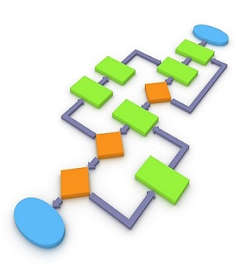
Course Outcomes
CO Number | Course Outcome
CO1 | Understand the concepts of object-oriented programming including programming process and compilation process.
CO2 | Apply different techniques to decompose a problem and programmed a solution with various concepts of object-oriented programming language.
CO3 | Analyse and explain the behaviour of linear data structure operations using the programming addressed in the course.
CO4 | Implement and evaluate the programs using the syntax and semantics of object-oriented programming.
CO5 | Design the solution of real-world problems in order to determine that the program performs as expected.

Slide 4

Scheme of Evaluation

Slide 5

QUEUE
A Queue is "an abstract data type in which elements are added to the rear and removed from the front; a 'first in, first out' (FIFO) structure."
A queue is a data structure that stores data in such a way that the last piece of data stored, is the last one retrieved
also called First-In, First-Out (FIFO)
Only access to the stack is the first and last element
consider people standing in line , they get service in the order that they arrive
http://www.cs.uregina.ca/Links/class-info/210/Queue/

Slide 6
Queues
Enque
operation to place a new item at the tail of the queue
Dequeue
operation to remove the next item from the head of the queue

Slide 7
Queue
start
end
X
A
M
enqueue(F)
start
end
start
end
X
A
M
F
A
M
F
item = dequeue()
item = X

Slide 8
ALGORITHM FOR INSERTION
1. If REAR=MAX then: write: Overflow & Exit
2. Read ITEM
If FRONT=0 then:
a) FRONT=FRONT+1
b) REAR=REAR+1
c) Q[REAR]=ITEM
else
REAR=REAR+1
Q[REAR]=ITEM
3. Exit

Slide 9
ALGORITHM FOR DELETION
If FRONT=0 then: write: “UNDERFLOW and Exit”
If FRONT=REAR, then:
Q[FRONT]=NULL
FRONT=0
REAR=0
else
Q[FRONT]=NULL
FRONT=FRONT+1
Exit

Slide 10
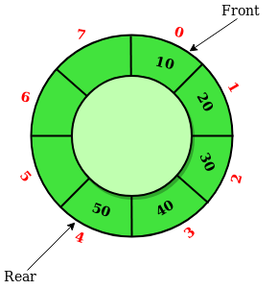
Circular Queue
Circular queue is a linear data structure in which the operations are performed based on FIFO (First In First Out) principle and the last position is connected back to the first position to make a circle. It is also called ‘Ring Buffer’.

Slide 11
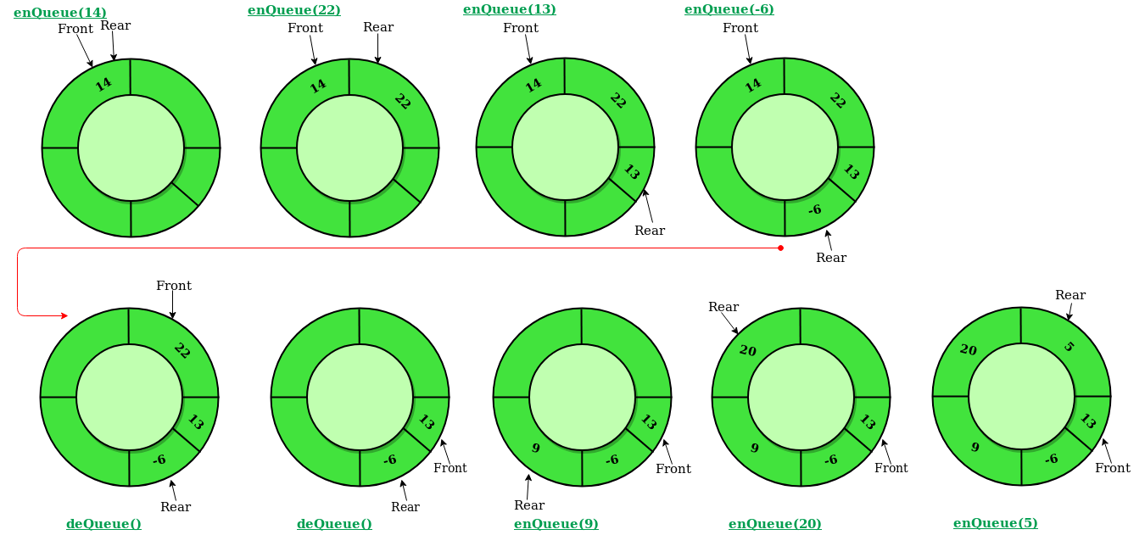
In a normal Queue, we can insert elements until queue becomes full. But once queue becomes full, we can not insert the next element even if there is a space in front of queue.

Slide 12
Operations on Circular Queue:
Front: Get the front item from queue.
Rear: Get the last item from queue.
enQueue(value) This function is used to insert an element into the circular queue. In a circular queue, the new element is always inserted at Rear position.
Steps:Check whether queue is Full – Check ((rear == SIZE-1 && front == 0) || (rear == front-1)).
If it is full then display Queue is full. If queue is not full then, check if (rear == SIZE – 1 && front != 0) if it is true then set rear=0 and insert element.
deQueue() This function is used to delete an element from the circular queue. In a circular queue, the element is always deleted from front position.

Slide 13
Steps:
Step 1:Check whether queue is Empty means check (front==-1).
Step 2:If it is empty then display Queue is empty. If queue is not empty then step 3
Step 3:Check if (front==rear) if it is true then set front=rear= -1 else check if (front==size-1), if it is true then set front=0 and return the element.
Time Complexity: Time complexity of enQueue(), deQueue() operation is O(1) as there is no loop in any of the operation.
Applications:
Memory Management: The unused memory locations in the case of ordinary queues can be utilized in circular queues.
Traffic system: In computer controlled traffic system, circular queues are used to switch on the traffic lights one by one repeatedly as per the time set.
CPU Scheduling: Operating systems often maintain a queue of processes that are ready to execute or that are waiting for a particular event to occur.

Slide 14
FAQ
1. Give any 2 applications of stack
2. Give any 2 applications of queue
3. Advantages of Stack over Queues

Slide 15
Applications of Queue
Print lines of a document
Simulation
Printer sharing between computers

Slide 16
REFERENCES
https://www.cs.cmu.edu/~adamchik/15-121/lectures/Stacks%20and%20Queues/Stacks%20and%20Queues.html
Data Structures with C/ schaum outline series/ volume 2
https://www.geeksforgeeks.org/stack-data-structure-introduction-program/
https://www.geeksforgeeks.org/queue-set-1introduction-and-array-implementation/
http://www.yashcode.com/2017/11/prefix-to-postfix-conversion-using-stack.html
Lipschutz, Seymour, “Data Structures”, Schaum's Outline Series, Tata McGraw Hill.
Gilberg/Forouzan,” Data Structure with C ,Cengage Learning.
Augenstein,Moshe J , Tanenbaum, Aaron M, “Data Structures using C and C++”, Prentice Hall of India.
Goodrich, Michael T., Tamassia, Roberto, and Mount, David M., “Data Structures and Algorithms in C++”, Wiley Student Edition.
Aho, Alfred V., Ullman, Jeffrey D., Hopcroft ,John E. “Data Structures and Algorithms”, Addison Wesley

Slide 17
THANK YOU

